Slide 1
INCOME TAX BILL
2025
BY CMA SALMAN PATHAN
22-03-2025
ICMAI-AURANGABAD CHAPTER OFFICE, CHHATRAPATI SAMBHAJINAGAR.

Slide 2
INCOME TAX BILL
2025

Slide 3
BIFERGATION OF INCOME TAX BILL-2025
(As Introduced in Parliament dated 13 th , February,2025)
There are XXIII Chapter in this Bill.
There are 538 section earlier was 700.
There are 622 pages in the bill.

Slide 4
CHAPTER - I
1. (1) This Act may be called the Income-tax Act, 2025.
(2) It extends to the whole of India.
(3) Save as otherwise provided in this Act, it shall come into force on the 1st April, 2026.

Slide 5
DEFINATIONS
2. In this Act, unless the context otherwise requires,— (1) “accountant” shall have the meaning assigned to it in section 515(3)(b);
(2) “Additional Commissioner” means a person appointed to be an Additional Commissioner of Income-tax under section 237(1);
(3) “Additional Director” means a person appointed to be an Additional Director of Income-tax under section 237(1);
(4) “advance tax” means the advance tax payable as per Chapter XIX-C;
(5) “agricultural income” means— (a) any rent or revenue derived from a land which is situated in India and is used for agricultural purposes;
(b) any income derived from such land by— (i) agriculture; or
(ii) the performance by a cultivator or receiver of rent-in-kind of any process ordinarily employed by a cultivator or receiver of rent-in-kind to render the produce raised or received by him fit to be taken to market; or (
iii) the sale by a cultivator or receiver of rent-in-kind of the produce raised or received by him, in respect of which no process has been performed other than a process of the nature described in item (ii);

Slide 6
(6) “amalgamation”, in relation to companies, means the merger of one or more companies with another company or the merger of two or more companies to form one company (the company or companies which so merge being referred to as the amalgamating company, and the companies and the company with which they merge or which is formed as a result of such merger being referred to as the amalgamated company) in such a manner that—
(a) all the property of the amalgamating company or companies immediately before the amalgamation become the property of the amalgamated company by virtue of the amalgamation;

Slide 7
(b) all the liabilities of the amalgamating company or companies immediately before the amalgamation become the liabilities of the amalgamated company by virtue of the amalgamation;
(c) the shareholders holding not less than three-fourths in value of the shares in the amalgamating company or companies (other than shares already held therein immediately before the amalgamation by, or by a nominee for, the amalgamated company or its subsidiary) become shareholders of the amalgamated company by virtue of the amalgamation, otherwise than as a result of the acquisition of the property of one company by another company pursuant to the purchase of such property by the other company or as a result of the distribution of such property to the other company after the winding up of the first-mentioned company;

Slide 8
ASSESSEE
(11) “assessee” means a person by whom any tax or any other sum of money is payable under this Act, and includes––
(a) every person in respect of whom any proceeding under this Act has been taken––
(i) for the assessment of his income or of the loss sustained by him or refund due to him; or
(ii) for the assessment of the income of any other person in respect of which he is assessable, or of the loss sustained by such other person or refund due to such other person;

Slide 9
(b) every person who is deemed to be an assessee under this Act;
(c) every person who is deemed to be an assessee in default under this act.

Slide 10
ASSESSING OFFICER
(12) “Assessing Officer” means —
(a) the Assistant Commissioner or Deputy Commissioner or Assistant Director or Deputy Director or the Income-tax Officer, who is vested with the relevant jurisdiction by virtue of directions or orders issued under section 241(1) or (2) or (3), or any other provision of this Act; or
(b) the Additional Commissioner or Additional Director or Joint Commissioner or Joint Director, who is directed under section 241(5)(b) to exercise or perform all or any of the powers and functions conferred on, or assigned to, an Assessing Officer under this Act;
(13) “assessment” includes reassessment and recomputation;

Slide 11
BOOKS OF ACCOUNTS
(19) “books or books of account”
includes ledgers, day-books, cash books, account-books or other books, whether kept–– (a) in written form; or
(b) in electronic or any digital form, or on cloud based storage, or on any electromagnetic data storage device, such as floppy, disc, tape, portable data storage device, external hard drives, or memory cards; or
(c) as print-outs of data stored in electronic or digital form or on storage devices mentioned in sub-clause (b); (NOTE : THERE SHOULD BE INCLUSION OF E-DATA MAINTAIN BY ANY SOFTWARE)

Slide 12
CAPITAL ASSETS
(22) “capital asset”
means— (a) property of any kind held by an assessee, whether or not connected with his business or profession;
(b) any securities held by a Foreign Institutional Investor or held by an investment fund specified in section 224(10)(a) which has invested in such securities as per the regulations made under the Securities and Exchange Board of India Act, 1992;
(c) any unit linked insurance policy issued on or after 1st February, 2021 to which exemption under Schedule II (Table: Sl. No. 2) does not apply,

Slide 13
but does not include—
(i) any stock-in-trade, other than the securities referred to in sub-clause (b), consumable stores or raw materials held for business or profession;
(ii) personal effects;
(iii) agricultural land in India, not being a land situated––
in any area comprised within the jurisdiction of a municipality (whether known as a municipality, municipal corporation, notified area committee, town area committee, town committee, or by any other name) or a cantonment board and which has a population of not less than ten thousand; or
in any area within the distance as specified in column C of the following Table, measured aerially from the local limits of any municipality or cantonment board referred to in item (A) and having population as referred to in column B of the said Table:—

Slide 14
SR.NO | Population of municipality or cantonment board | Within distance, measured aerially, from local limits of any municipality or cantonment board not being more than
1 | More than 10,000 but less than 1,00,000 | Two kilometres
2 | 1,00,000 and above, but less than 10,00,000. | Six kilometres.
2 | 10,00,000 and above | Eight kilometres.

Slide 15
VIRTUAL DIGITAL ASSET
(111) “virtual digital asset” means— (
a) any information or code or number or token (not being Indian currency or foreign currency), generated through cryptographic means or otherwise, called by any name, providing a digital representation of value exchanged with or without consideration, with the promise or representation of having inherent value, or functions as a store of value or a unit of account including its use in any financial transaction or investment, but not limited to investment scheme; and can be transferred, stored or traded electronically

Slide 16
(b) a non-fungible token or any other token of similar nature, by whatever name called;
(c) any other digital asset, as the Central Government may, by notification, specify,
(d) any crypto-asset being a digital representation of value that relies on a cryptographically secured distributed ledger or a similar technology to validate and secure transactions,
whether or not such asset is included in sub-clause (a) or (b) or (c), where,––
(i) “non-fungible token” means such digital asset as the Central Government may, by notification, specify;
(ii) the Central Government may, by notification, exclude any digital asset from this definition, subject to such conditions as specified therein;

Slide 17
CHAPTER-II
BASIS OF CHARGE

Slide 18
INCOME TAX
4. (1) Income-tax for any tax year shall be charged as per the provisions of this Act at the rate or rates which are enacted by a Central Act for such tax year.
(2) The charge of income-tax under sub-section (1) shall be on the total income of the tax year of every person as per the provisions of this Act. (
3) Income-tax shall also include any additional income-tax, by whatever name called, levied under this Act.
(4) If this Act provides that income-tax is to be charged in respect of income of a period other than the tax year, it shall be charged accordingly.
(5) For the income chargeable under sub-section (2), income-tax shall be deducted or collected at source or paid in advance as provided under this Act.

Slide 19
RESIDENT OF INDIA
6. (1) For the purposes of this Act, residence of a person in India shall be determined as per this section.
(2) An individual shall be resident in India in a tax year, if he––
(a) is in India for a total period of one hundred and eighty-two days or more in that tax year; or
(b) is in India cumulatively for sixty days or more during that year and has been in India cumulatively for three hundred and sixty-five days or more in the four years preceding such tax year.

Slide 20
ACCOUNTING PERIOD
e) the expression “accounting period” in clause (d) means––
each period of twelve months ending with the 31st March;

Slide 21
CHAPTER IV
COMPUTATION OF TOTAL INCOME
13. Save as otherwise provided in this Act, all incomes shall, for the purposes of charge of income-tax and computation of total income, be classified under the following heads of income:—
Salaries;
Income from house property;
Profits and gains of business or profession;
Capital gains; and
Income from other source

Slide 22
SALARY
B.—Salaries 15. (1) The following income shall be chargeable to income-tax under the head “Salaries”:—
(a) any salary due from an employer to an assessee in the tax year, whether paid or not;
(b) any salary paid or allowed to him in the tax year by or on behalf of an employer though not due or before it became due to him;
(c) any arrears of salary paid or allowed to him in the tax year by or on behalf of an employer, if not charged to income-tax for any earlier tax year.
(2) For the purposes of sub-section (1), employer includes former employer.
(3) If any salary paid in advance is included in the total income of any person for any tax year, it shall not be included again in the total income of such person when the salary becomes due.

Slide 23
Income from house property
(1) The annual value of property consisting of any buildings or lands appurtenant thereto, owned by the assessee shall be chargeable to income-tax under the head “Income from house property”.

Slide 24
Profits and gains of business or profession
The income from any business or profession carried on by the assessee at any time during the tax year shall be chargeable to income-tax under the head “Profits and gains of business or profession”.

Slide 25
Capital gains
Any profits or gains arising from the transfer of a capital asset effected in a tax year shall, save as otherwise provided in sections 82, 83, 84, 86, 87, 88 and 89, be chargeable to income-tax under the head “Capital gains” and shall be deemed to be the income of the tax year in which the transfer took place

Slide 26
Income from other sources
92. (1) Income of every kind which is not to be excluded from the total income, shall be chargeable to income-tax under the head “Income from other sources”, if it is not chargeable to income-tax under any of the heads specified in section 13(a) to (d).

Slide 27
(a) any dividend;
(b) any winning from lotteries, crossword puzzles, races including horse races, card games and other games of any sort or from gambling or betting of any form or nature;
(c) any sum received by the assessee from employees as contributions to any provident fund, superannuation fund, any fund set up under the Employees’ State Insurance Act, 1948, or any other fund for the welfare of such employees, if the income in not chargeable to income-tax under the head “Profits and gains of business or profession”;
(d) any sum received under a Keyman insurance policy, as defined Schedule II (Note 1) including the bonus allocated on such policy, if such income is not chargeable to income-tax under the head “Profits and gains of business or profession” or under the head “Salaries”;
(e) any income by way of interest on securities, if the income is not chargeable to income-tax under the head “Profits and gains of business or profession”;

Slide 28
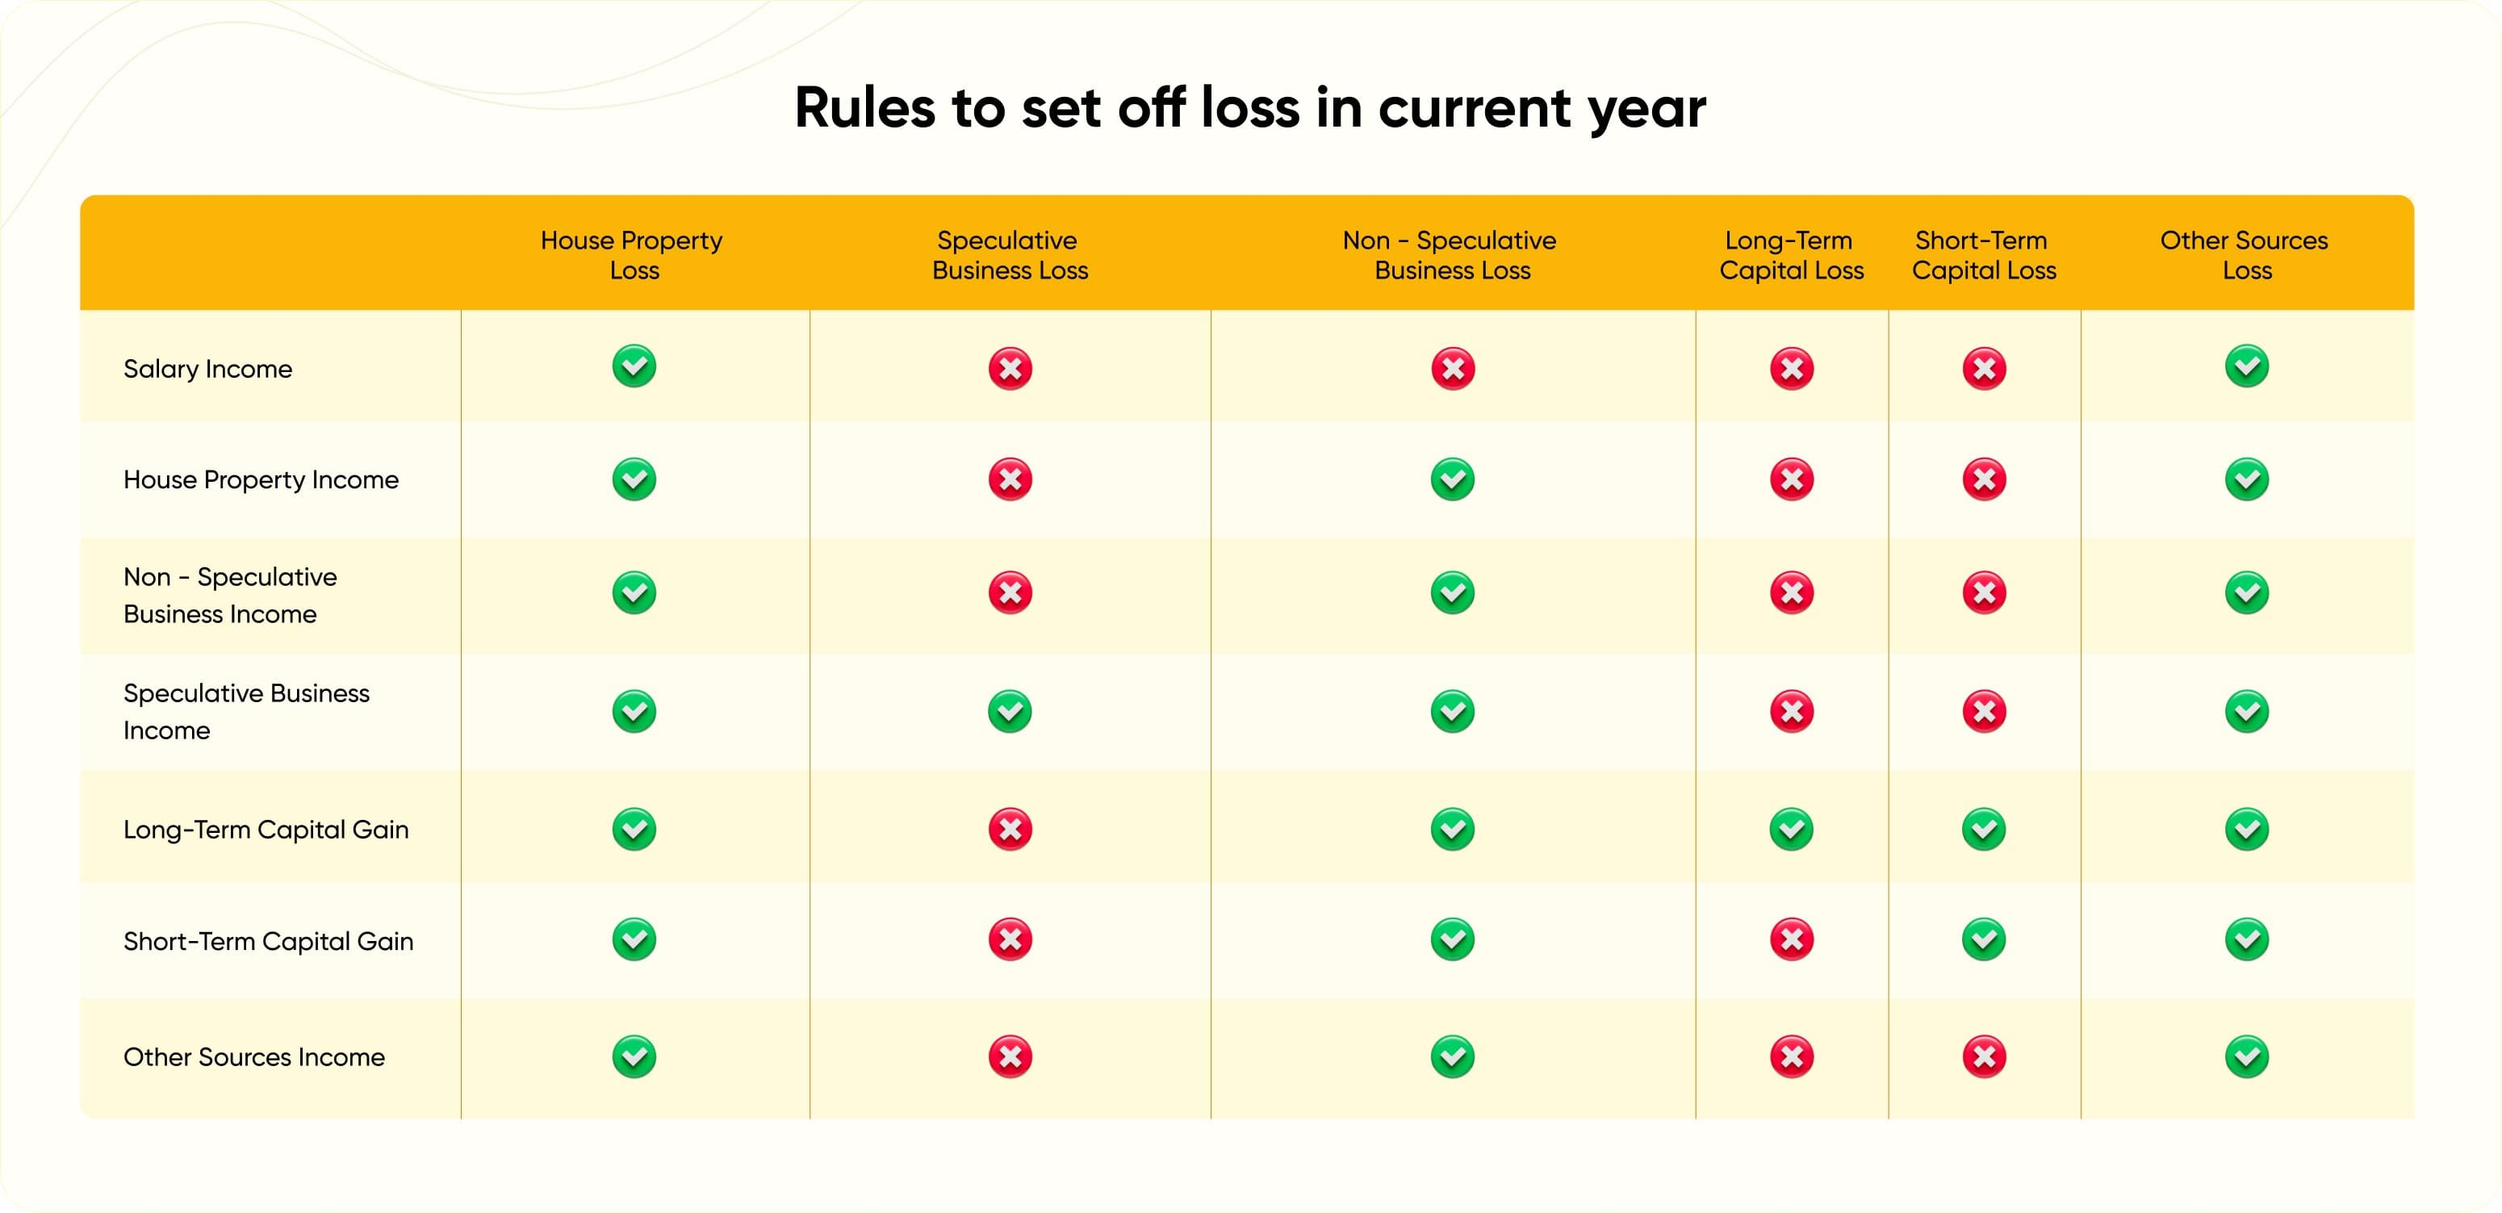
CHAPTER VII SET OFF, OR CARRY FORWARD AND SET OFF OF LOSSES

Slide 29
DEFINATION OF ACCOUNTANT
Under Section 515(3)(b) of the Income Tax Bill, 2025, an “accountant” continues to mean a Chartered Accountant (CA) as defined under Section 2(1)(b) of the Chartered Accountants Act, 1949, who holds a valid Certificate of Practice under Section 6(1) of that Act​.

Slide 30
WHAT SHOULD BE DEFINATION OF ACCOUNTANT UNDER SECTION 513(3)(B)
“accountant” means a chartered accountant within the meaning of the Chartered Accountants Act, 1949 and who holds a valid certificate of practice under sub-section (1) of section 6 of that Act,
Or
(ii) a cost accountant within the meaning of the Cost and Works Accountants Act, 1959;
Or
(i) a company secretary within the meaning of the Company Secretaries Act, 1980;

Slide 31
THANKS

